Slide 1
EP315 Microprocessors for Physicists
Control
Readout
Physics Experiment

Slide 2
Simple control
Decrease temp setting
AC
Room is Hot
Feedback control
Decrease temp setting
AC
Stop AC
Room is cool
comfortable

Slide 3
AC
Room
Desired Setting = R ◦C
Measure Y ◦C
P
I
D
PROPORTIONAL
Control
INTEGRAL
Control
DERIVATIVE
Control
Inject cool air
∝ (R – Y)
Inject cool air
∝ ∫(R – Y)dt
Inject cool air
∝ d(R – Y)/dt

Slide 4
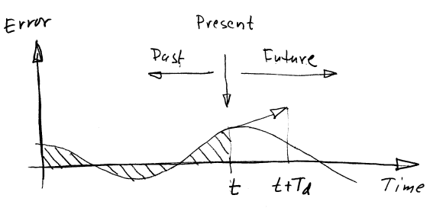
AC
Room
Desired Setting = R ◦C
Measure Y ◦C
PID controller applies correction u(t) based on past (integral), present (proportional) & future (derivative)
Time constants – these are
determined by the time lag in response τ_{delay} of the plant to a step function input in open loop mode. Ratios Τ_{i}/ τ_{delay} and Τ_{d}/ τ_{delay}
Are determined by Zeigler-Nichols tuning.
… or more useful in practice →

Slide 5
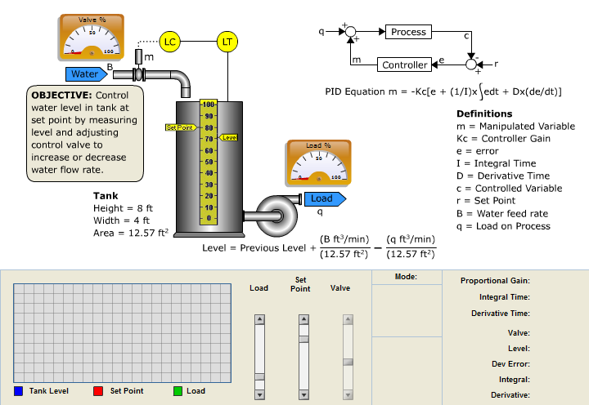
Domestic control example with PID feedback:
Set and maintain the water level in a tank

Slide 6
References:
http://dexautomation.com/ps/ : flash simulation of PID
… and many others
Accompanying notes on Zeigler Nichols tuning of PID control loop parameters “PracticalTechniquesForPIDTuning”
Lab 03 – PID controller implementation!

